Slide 1
Legislative Finance Committee Meeting
July 13, 2011
Facilities Management Update
Catherine D. Torres, M.D., Cabinet Secretary

Slide 2
New Mexico Department of Health
Mission
Provide leadership to guide public health and
to protect the health of all New Mexicans.
Vision
A healthy state of mind!

Slide 3
Strategies
Establish corporate compliance office within the Office of General Counsel
Establish a comprehensive independent peer review
Establish a centralized billing process within Office of Facilities Management
Improve employee satisfaction
Evaluate quality indicators and establish action plan in a timely manner
Decrease overtime by 50%

Slide 4
Goals
Ensure that all DOH facilities meet or surpass national quality and safety standards.
Develop and implement standard guidelines and procedures for all DOH facilities that are derived from best practices and patient/resident-centered models.
Implement financial accountability standards facility-wide to maximize third party reimbursement.
Identify national benchmarks of quality by facility type. Assess current operations against benchmarks and establish thresholds of acceptability which are integrated into a continuous quality improvement process.

Slide 5
Goals
Establish peer review systems for clinicians practicing in DOH facilities that are discipline specific, cultivate best practices through education, and serve to improve the quality of care delivery across multidisciplinary systems.
Develop workgroups to identify and implement best practices across facilities to include: Substance Abuse Treatment, Long-Term Care, Nursing, and Quality Improvement.
Develop and implement the use of standardized indicators with which to measure, analyze and improve quality care and services.

Slide 6
Facilities’ Fiscal Accomplishments
Ended the past two fiscal years without the need to request a deficiency or supplemental appropriation
Turquoise Lodge increased bed capacity and generated revenue, which decreased the need for General Fund
NM Behavioral Health Institute increased 3rd party revenue by approximately 13.7%, which decreased the need for General Fund
NM State Veterans’ Home is fully funded by 3rd party revenue, eliminating the need for General Fund
Fort Bayard Medical Center has maintained Medicare and Medicaid certification since January 2009and is currently obtaining certification for VA per diem

Slide 7
FY12 Operating Budget Totals
(Whole Numbers)
FY12 OPERATING BUDGET
General Funds | $62,477,000
Federal Funds | $0
Other State Funds | $76,178,800
Inter-Agency Transfers | $713,800
TOTAL: | $139,369,600

Slide 8
FY12 Operating Budget by Facility and Revenue Source
(In Thousands)

Slide 9
FY11 3rd Party Revenue Billed and Collected as of May 2011
(Whole Numbers)

Slide 10
Percentage of FY11 3rd Party Revenue
Billed and Collected by Facility

Slide 11
FY10-FY12 Percentage of General Fund
by Facility

Slide 12
FY11 Estimated Actuals v. FY12 Operating Budget
(In Thousands)
Revenue | FY11 Projections | FY12 Operating Budget | FY11 Projections Over / (Under) FY12 OpBud
General Fund | $ 59,238.8 | $ 62,477.0 * | $ 3,238.2
Other Transfers | $ 884.2 | $ 713.8 | ($ 170.4)
Federal Funds | $ 234.4 |  | ($ 234.4)
Other Revenue | $ 74,411.7 | $ 76,178.8 | $ 1,767.1
Total | $ 134,769.1 | $139,369.6 | $4,600.5
Expenditures
Personal Services & Employee Benefits | $106,674.8 | $108,849.0 | $ 2,174.1
Contractual Services | $ 7,669,9 | $ 7,780.7 | $ 110.7
Other Operating Costs | $ 18,773.5 | $ 22,739.9 * | $ 3,966.4
Other Financing Uses | $ 0 | $ 0 | $ 0
Total | $133,118.3 | $139,369.6 | $ 6,251.2
FTE
Total FTE | 2,295 | 2,224 | (71)
*The increase in General Fund is for the Forte Bayard Lease Payment

Slide 13
FTE Totals by Facility
Including Vacancy Rate
 | FY 09 |  |  |  |  | FY 10 |  |  |  |  | FY 11
Facility | Perm | Term | Temp | Total | Vac Rate | Perm | Term | Temp | Total | Vac Rate | Perm | Term | Temp | Total | Vac Rate
TLH | 74.0 |  |  | 74.0 | 18% | 74.0 |  | 3.0 | 77.0 | 22% | 72.0 | 5.0 | 3.0 | 80.0 | 23%
NMBHI | 1012.5 |  | 12.0 | 1024.5 | 8% | 1028.5 |  |  | 1028.5 | 11% | 1022.5 |  |  | 1022.5 | 15%
NMRC | 118.0 |  |  | 118.0 | 19% | 118.0 |  |  | 118.0 | 23% | 115.0 |  |  | 115.0 | 26%
SATC | 129.0 |  |  | 129.0 | 11% | 130.0 |  | 5.0 | 135.0 | 12% | 129.0 |  | 5.0 | 134.0 | 13%
NMVH | 232.5 |  |  | 232.5 | 18% | 232.5 |  |  | 232.5 | 14% | 231.0 |  | 0.5 | 231.5 | 15%
FBMC | 363.0 |  |  | 363.0 | 19% | 367.0 |  |  | 367.0 | 17% | 362.0 |  |  | 362.0 | 16%
LLCP | 334.0 |  | 15.0 | 349.0 | 8% | 335.0 |  | 15.0 | 350.0 | 13% | 335.0 |  | 15.0 | 350.0 | 18%
TOTAL | 2263.0 | 0.0 | 27.0 | 2290.0 | 14% | 2285.0 |  | 23.0 | 2308.0 | 16% | 2266.5 | 5.0 | 23.5 | 2295.0 | 18%

Slide 14
FY07-FY11 Overtime Totals
(Whole Numbers)
* FY10 and FY11 actuals include stand-by, on-call and call-back pay.

Slide 15
FY09-FY11 Overtime Totals by Facility
(Whole Numbers)

Slide 16
Information Technology

Slide 17
Total Number of Computers by Facility

Slide 18
Computer Replacement FY09-FY11
by Facility

Slide 19
Percentage of Computers Replaced Since FY09
by Facility

Slide 20
Time-Keeping Systems
 | TL | NMBHI | NMRC | SATC | NMSVH | FBMC | LLCP
Time Clocks | 2 | 27 | 2 | 1 | 4 | 4 | 2
Biometrics |  |  |  |  |  |  | 27
Kronos project completed it in June 2010
Provides standardized time keeping policies and procedures across all seven facilities
Ability to query time keeping data to identify issues or trends in work attendance, performance
Ability to manage workforce staffing to provide for adequate staffing to meet necessary ratios
Automated update between Kronos and SHARE reducing error and time for payroll
Ability to manage work schedules to plan effectively and reduce the amount of unnecessary overtime

Slide 21
Upgrade Information Technology Costs
(Estimation)
Item | Amount
Avatar Hardware: 2 servers | $ 24,490.02
Worx Hardware: 1 server | $ 16,499.34
Software: Cache 64 bit license for Windows | $ 223,272.00
Services: Migrate Avatar from AIX to Windows in test environment – October 1 or sooner (Depends upon small contract execution) | $28,330.00
Migrate Avatar from AIX to Windows in production environment – Nov 1 or sooner (Depends upon small contract execution) | $21,371.00
Page 1 Total: | $313,962.36

Slide 22
Upgrade Information Technology Costs
(Estimation)
Item | Amount
Implement ECP server – Dec 31 or sooner (optional) | $14,112.00
Upgrade PM, CWS and RAD (included in current contract) | $23,600.00
Upgrade Worx – before October 31, 2011 (included in current contract) | $9,796.50
Migrate Worx to Windows – before December 31, 2011 | $12,000.00
Maintenance Increase ($3,931.25 per month) | $47,175.00
Page 2 Total: | $106,683.50
Grand Total: | $420,645.86
Software upgrades
From: To:
PM 2006 PM 2008
CWS 2004 CWS 2010
RAD 2004 RAD 2010
Cache 5.0.10 Cache 2008

Slide 23
FY12 Software Upgrades
Upgrade From: | To:
PM 2006 | PM 2008
CWS 2004 | CWS 2010
RAD 2004 | RAD 2010
Cache 5.0.10 | Cache 2008

Slide 24
Performance Measures
In FY11, the Facilities Management Program has seven performance measures:
Number of substantiated cases of abuse, neglect and exploitation (ANE) per one hundred residents in agency-operated long-term care programs confirmed by the division of health improvement (quarterly)
Percent of clients at New Mexico Rehabilitation Center with continued improvement on medical rehab goals three to six months post discharge (annual)
Percent of clients at Sequoyah Adolescent Treatment Center without relapses at three to six months post discharge (annual)
Percent of clients at Turquoise Lodge without relapses at three to six months post discharge (annual)

Slide 25
Performance Measures
Percent of operational capacity beds filled at all agency facilities (quarterly)
Percent of billed third party revenues at all agency facilities (quarterly)
Total dollar amount of uncompensated care at all facilities (quarterly)

Slide 26
Abuse, Neglect and Exploitation
FY11
Target: 0
* There was one substantiated case of ANE in Q3 changing a two and a half year history of zero ANE.
.

Slide 27
Billed 3rd Party Revenues
FY11 Target: 75%

Slide 28
Exceeded Target
FY11 Target: 90%

Slide 29
Exceeded Target
FY11 Target: Below $40 million
Total: $30,235,223
* Currently reviewing the collection methodology and validity of these results.

Slide 30
FY12 Performance Measures
In FY12, the Facilities Management Program has four performance measures:
Number of substantiated cases of abuse, neglect and exploitation per one hundred residents in agency-operated long-term care programs confirmed by the division of health improvement or adult protective services
Percent of operational capacity beds filled at all agency facilities
Percent of billed third party revenues at all agency facilities
Total dollar amount of uncompensated care at all facilities

Slide 31
FY13 Proposed Performance Measures
In FY13, the Facilities Management Program is proposing four performance measures:
Zero tolerance of substantiated cases of abuse, neglect and exploitation (ANE) in Department of Health’s facilities
95% of operational beds filled at all agency facilities
90% collectable billed third-party revenues at all agency facilities
Zero tolerance of patient falls with injury per thousand patient days at all agency facilities

Slide 32
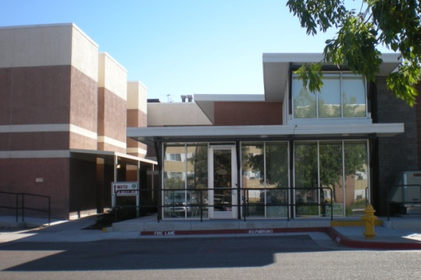
Turquoise Lodge Hospital (TLH)
TLH is a hospital for medical and psychological treatment of complex drug withdrawal such as withdrawal from alcohol, heroin, or tranquilizers complicated by co-occurring major medical and psychiatric illness.
Medical staffing includes specialists in addiction treatment, adult internal medicine, and psychiatry.
TLH also offers inpatient addiction rehabilitation.
Our counseling staff offers intensive rehabilitation services for individuals dealing with severe addiction problems.
TLH serves the entire state of NM. The program revolves around a 30 day in patient stay.

Slide 33
Turquoise Lodge Hospital (TLH)
The Medical Observation and Treatment Unit (MOTU) is TLH’s new urgent care unit that provides rapid medical assessment and stabilization for addicted patients.
The MOTU serves patients from Bernalillo County.
Generates $1.2 million and supports 5 DOH FTEs.
The MOTU is designed to care for intoxicated patients brought in by Emergency Medical Services (EMS), who would otherwise be taken to a local hospital emergency department (ED).
The purpose of this program is to decrease the load on local EDs and provide more appropriate services to addicted individuals, by offering them focused supportive care and the opportunity to enter into treatment for their addiction after they are no longer intoxicated.

Slide 34
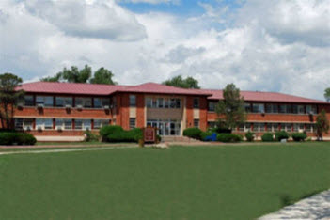
NM Behavioral Health Institute
The New Mexico Behavioral Health Institute (NMBHI) is the only state owned and operated psychiatric hospital in New Mexico.
NMBHI is made up of five clinical divisions serving a wide range of public needs. Each division is separately licensed and has its own unique admission criteria.
The most familiar is the inpatient care we offer adult psychiatric patients. We provide adult psychiatric services on six units, serving approximately 1000 admissions per year.
Our adolescent program is dedicated to treating adolescent sex offenders.

Slide 35
NM Behavioral Health Institute
Our forensic division offers competency evaluation and treatment for adult patients who have allegedly committed a felony. We also provide treatment for adult sex offenders .
NMBHI is a major regional licensed long-term nursing care provider for elderly and disabled residents. It is CMS certified, accredited by The Joint Commission and provides specialty services for dementia care in both elderly and younger residents.
Outreach services are gaining a whole new meaning at NMBHI with the advent of telemedicine. With this technology we are able to assess patients who are in other parts of the state or provide consultation to health care providers in those regions.
In addition, NMBHI offers community based services through a comprehensive community mental health agency that offers many individual programs.

Slide 36
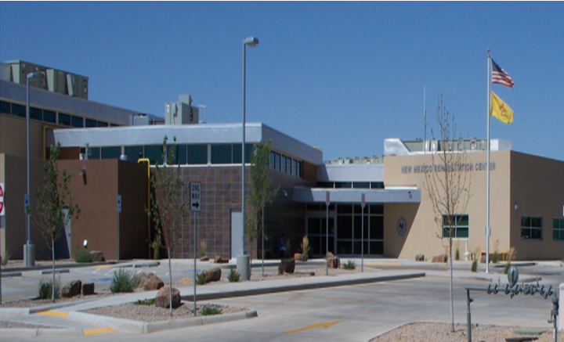
NM Rehabilitation Center
Located in Roswell, the New Mexico Rehabilitation Center offers a wide range of rehabilitation services, including physical and occupational therapy, speech and language pathology, social services, psychological services and a chemical dependency program.
NMRC is Joint Commission accredited. NMRC is recognized as a safety net hospital in the state for inpatient rehabilitation. Locally, NMRC is the only inpatient rehab specialty hospital within a 200 mile radius. The building was completed in December 2010, move-in date was in March.

Slide 37
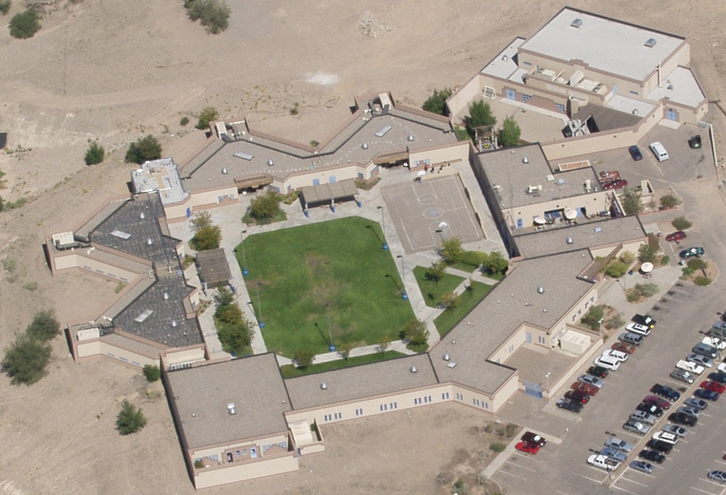
Sequoyah Adolescent Treatment Center
Sequoyah Adolescent Treatment Center in Albuquerque is a licensed, Joint Commission for the Accreditation of Health Care Organizations (JCAHO) accredited 36-bed secure residential behavioral healthcare treatment facility for adolescent boys 12 to 18 years of age.
The boys in residence at Sequoyah exhibit a full array of mental health problems and psychiatric disorders, have a history of violent behavior or are prone to violent behavior.
The facility is owned and managed by the New Mexico Department of Health.
Although Sequoyah is not a correctional facility, approximately twenty percent of the residents are under commitment to the State Juvenile Correctional system.

Slide 38
Sequoyah Adolescent Treatment Center
Sequoyah utilizes the multidisciplinary team approach to treatment in a culturally sensitive environment that addresses the individual needs of the resident.
Contributions from education, milieu, nursing, psychiatry, psychology, recreation and social work, are integrated into an individualized treatment plan.
The treatment plan is explained in terms the residents and their families can understand and are reviewed every thirty days.
Clinical services provided include individual, group and family therapies, art therapy, educational services, medical services, medication management, pet therapy, neuropsychiatric services, social services, speech and language therapy, and therapeutic recreational activities.

Slide 39
Sequoyah Adolescent Treatment Center
Contract services provided include dental, non-denominational religious services, nutritional planning, optometry, pediatric, pharmacy, portable X-ray and EKG services.
In addition to being licensed as a treatment center, Sequoyah maintains an accredited state supported school staffed by a Director of Education, speech pathologist, four licensed teaching staff representing both regular and special education, and a variety of contracted related service providers such as a schools psychologist, bilingual evaluators, occupational therapist, and a librarian.
Grades and transcripts are provided for each student and all earned credits transfer back to their district school.

Slide 40
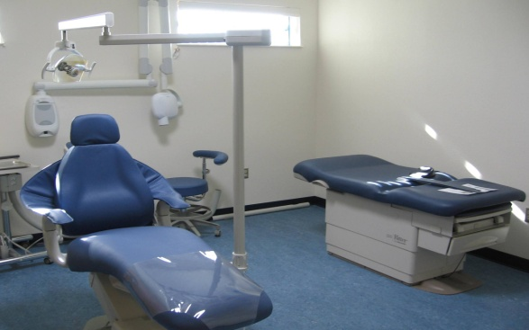
Sequoyah Adolescent Treatment Center
New Medical Wing - The new 3121 square foot Medical Wing at Sequoyah will support the current 36-bed facility.
The Medical Wing will include dental and medical exam rooms, nursing station, and a secure medication dispensing room.
Once completed, the Medical Wing will house Sequoyah’s Medical Director, Director of Nursing, Infection Control Nurse, Nursing, and all medical support staff and medical contractors.
Construction began in April of 2010, project is scheduled to be completed by late summer or early fall of 2011.

Slide 41
NM State Veteran’s Home
The New Mexico State Veterans’ Home (NMSVH) is the exclusive long-term care home for Veterans, spouses of Veterans and Gold Star parents in New Mexico.
Situated on 16 acres in Truth or Consequences, NMSVH provides inpatient long term care services at 3 levels: Domiciliary-10 beds (assisted living), Intermediate Care (ICF)-135 beds (nursing care) and Skilled Nursing (SNF)-beds included in ICF (more acute care).
NMSVH also has an Alzheimer’s unit serving 20 residents (included in the total bed count).

Slide 42
NM State Veteran’s Home
NMSVH provides inpatient and outpatient PT, OT and SLP services by physician orders; inpatient and outpatient Laboratory services; inpatient and outpatient Aquatic therapy program; Onsite Pharmacy.
All services are provided under the direction of an onsite, fulltime MD, Pharmacist and Physician’s Assistant.
History: The NMSVH has been in operation for 25+ years (1985-2011) and was originally under the direction of the (then) Veterans Service Commission. It was transferred to the NM Department of Health after operational difficulties and has been under our direction ever since.
NMSVH has had a history of generating enough income to be self-sustaining with minimal General Fund contributions. For the past two years, it has received no General Fund. There is no General Fund appropriation for FY12.

Slide 43
NM State Veteran’s Home
NMSVH has an excellent history of support from local and statewide Veterans’ groups (DAV, VFW, Military Bases, etc.). We continue to receive monetary donations from individuals and groups for the use by the Veterans. In addition, these groups frequently visit the facility and all staff and residents interact on a routine basis.
The facility is currently in the process of building a new facility to augment services to the clientele.
The new buildings will house 3-13 beds houses for Alzheimer’s care and 2-10 bed houses for Skilled Nursing Care.
The new buildings will also house a therapy department providing services to those in-patients and out-patients as required.

Slide 44
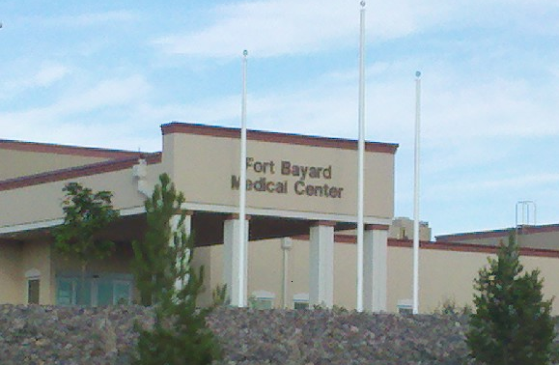
Fort Bayard Medical Center
Fort Bayard Medical Center (FBMC) is a licensed and certified, 200-bed, long-term intermediate and skilled care facility. FBMC also offers chemical dependency treatment at Yucca Lodge Chemical Dependency Treatment Center.
Fort Bayard State Veterans Home is a licensed and certified, 40-bed neighborhood specific for: Honorably discharged veterans with 90 days or more of service and their spouses as well as Gold Star Parents, who have lost children in the service of their country.
FBMC provides care for people who have a medical need and who can no longer provide care for themselves such as behavioral problems, organic brain problems, personality disorders, diabetes, heart problems, cerebral vascular disease, chronic obstructive pulmonary disease, and atherosclerotic cardio-vascular disease.

Slide 45
Fort Bayard Medical Center
FBMC offers skilled care to people who need rehabilitative services or a higher degree of medical care.
In addition to full nursing care and in-house physicians, Fort Bayard Medical Center also offers social services, activity therapy, physical therapy, occupational therapy, speech/language pathology and restorative care therapies, case management, laboratory and X-ray services, pharmacy and transportation services.
The new Fort Bayard Medical Center facility was completed in September 2010 and we had a ribbon cutting ceremony in October 2010. The new 200 bed facility was occupied and residents moved over November 2010.
We are a training site for nursing students for Western New Mexico University.

Slide 46
Fort Bayard Medical Center
FBMC has just initiated an electronic Medication Administration Record-MAR that is going in service July 2011.
FBMC via telemedicine is participating with experts in the Division of geriatrics with a particular focus on dementia and palliative care.

Slide 47
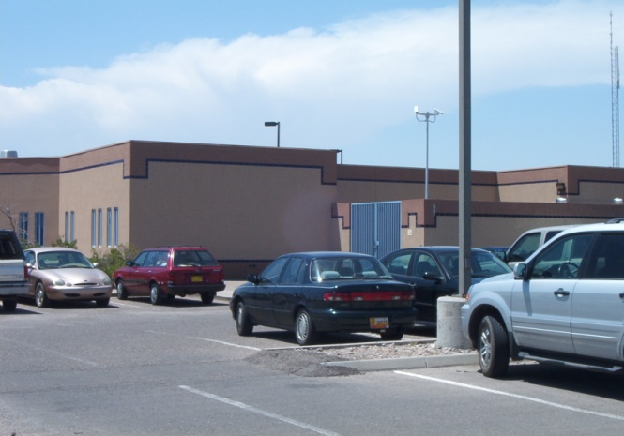
Los Lunas Community Program
The Los Lunas Community Program (LLCP) serves individuals with developmental disabilities in the Intermediate Care Facility for Mental Retardation (ICF/MR) and Medicaid Waiver programs.
LLCP provides individual consumers an opportunity to live in community-based group homes or family living situations.
In addition, LLCP provides a wide range of day program services in community day habilitation, vocational training, assistance in job searching, and job coaching.
LLCP also serves as the state "Safety Net" for individuals with developmental disabilities who are in crisis situations.

Slide 48
Los Lunas Community Program
Within LLCP's residential and family living census, 43 individuals are Jackson Class Members.
Many are severely medically fragile; other clients served by LLCP are behaviorally challenged and require increased staffing and single person residences to assure client’s continued health and safety.
LLCP also provides multiple crisis services: Tier II and III Waiver medical and behavioral crisis, and placement for individuals civilly committed.

Slide 49
Los Lunas Community Program
Community Practice Review for 2010 (completed in February 2011) showed significant improvement compared to the previous 2 years based upon data provided by the community monitor.
Consolidation of residential homes has effectively reduced lease expenditures and overtime costs.
Overall billing recoupment has improved and been maintained over the past two years-currently 98%.
The Natatorium on the Los Lunas State Campus was recently renovated.

Slide 50
Thank you!

